Slide 1
第二章 实数
二次根式的加减运算
Notes:
全品初中

Slide 2
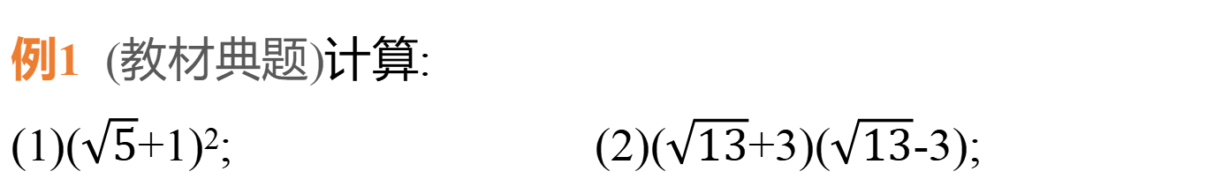
应用一 运算法则和运算律在二次根式运算中的应用
例1 (教材典题)计算:
(1)($\sqrt{5}$+1)²; (2)($\sqrt{13}$+3)($\sqrt{13}$-3);
  解:(1)($\sqrt{5}$+1)²=($\sqrt{5}$)²+2$\sqrt{5}$+1²=5+2$\sqrt{5}$+1=6+2$\sqrt{5}$.
  (2)($\sqrt{13}$+3)($\sqrt{13}$-3)=($\sqrt{13}$)²-3²=13-9=4.

Slide 3
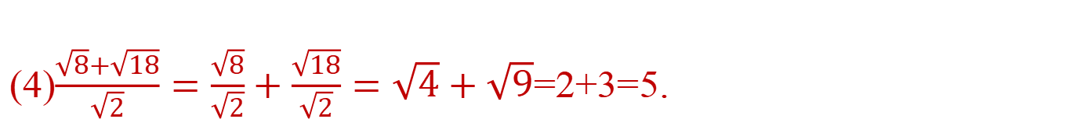
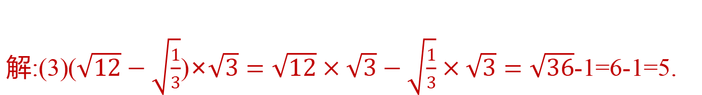
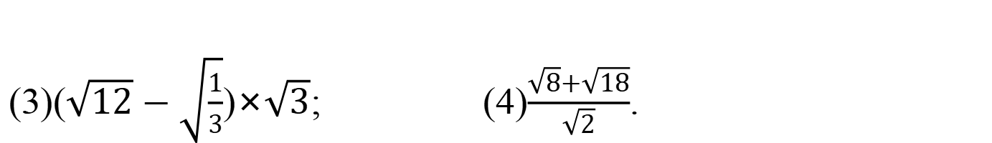
(3)($\sqrt{12}−\sqrt{\frac{1}{3}}$)×$\sqrt{3}$; (4)$\frac{\sqrt{8}+\sqrt{18}}{\sqrt{2}}$.
  解:(3)($\sqrt{12}−\sqrt{\frac{1}{3}}$)×$\sqrt{3}=\sqrt{12}×\sqrt{3}−\sqrt{\frac{1}{3}}×\sqrt{3}=\sqrt{36}$-1=6-1=5.
  (4)$\frac{\sqrt{8}+\sqrt{18}}{\sqrt{2}}=\frac{\sqrt{8}}{\sqrt{2}}+\frac{\sqrt{18}}{\sqrt{2}}=\sqrt{4}+\sqrt{9}$=2+3=5.

Slide 4
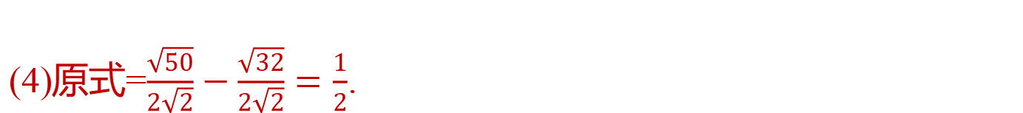
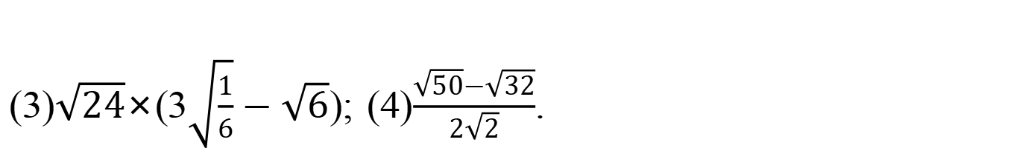
变式 计算:(1)(2$\sqrt{3}$-1)²; (2)(2$\sqrt{2}$-3$\sqrt{3}$)(3$\sqrt{3}$+2$\sqrt{2}$);
(3)$\sqrt{24}$×(3$\sqrt{\frac{1}{6}}−\sqrt{6}$); (4)$\frac{\sqrt{50}−\sqrt{32}}{2\sqrt{2}}$.
  解:(1)原式=(2$\sqrt{3}$)²-2×2$\sqrt{3}$×1+1²=13-4$\sqrt{3}$.
  (2)原式=(2$\sqrt{2}$)²-(3$\sqrt{3}$)²=8-27=-19.
  (3)原式=3$\sqrt{4}−\sqrt{144}$=6-12=-6.
  (4)原式=$\frac{\sqrt{50}}{2\sqrt{2}}−\frac{\sqrt{32}}{2\sqrt{2}}=\frac{1}{2}$.

Slide 5
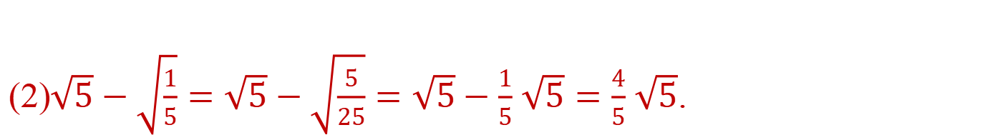
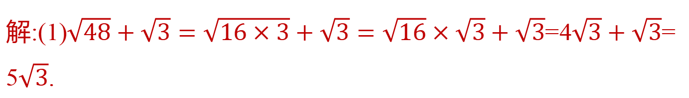
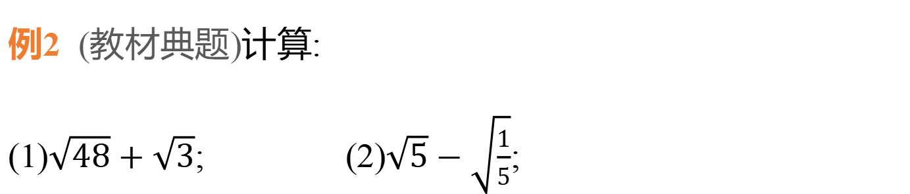
应用二 二次根式的加减运算
例2 (教材典题)计算:
(1)$\sqrt{48}+\sqrt{3}$; (2)$\sqrt{5}−\sqrt{\frac{1}{5}}$;
  解:(1)$\sqrt{48}+\sqrt{3}=\sqrt{16×3}+\sqrt{3}=\sqrt{16}×\sqrt{3}+\sqrt{3}$=4$\sqrt{3}+\sqrt{3}$= 5$\sqrt{3}$.
  (2)$\sqrt{5}−\sqrt{\frac{1}{5}}=\sqrt{5}−\sqrt{\frac{5}{25}}=\sqrt{5}−\frac{1}{5}$ $\sqrt{5}=\frac{4}{5}$ $\sqrt{5}$.

Slide 6
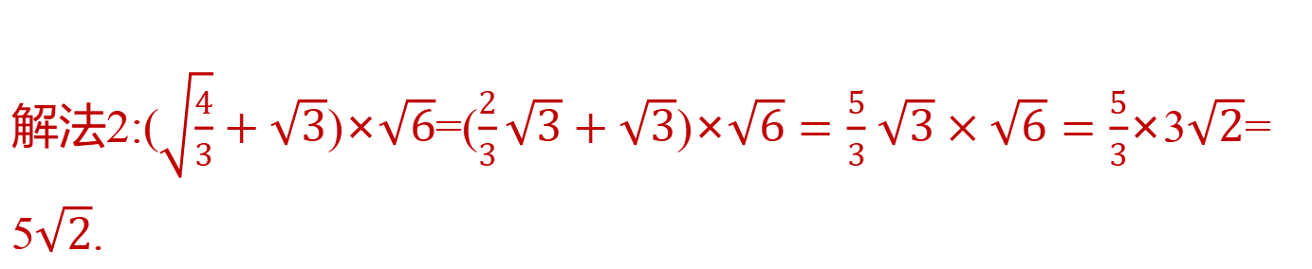
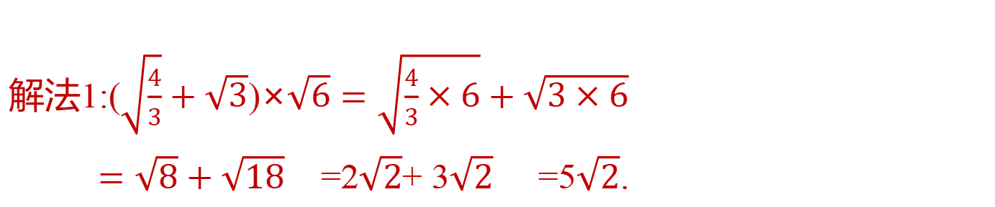
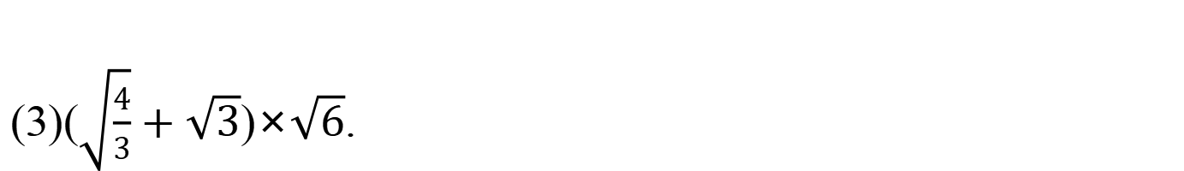
(3)($\sqrt{\frac{4}{3}}+\sqrt{3}$)×$\sqrt{6}$.
  解法1:($\sqrt{\frac{4}{3}}+\sqrt{3}$)×$\sqrt{6}=\sqrt{\frac{4}{3}×6}+\sqrt{3×6}$
  $=\sqrt{8}+\sqrt{18}$ =2$\sqrt{2}$+ 3$\sqrt{2}$ =5$\sqrt{2}$.
  解法2:($\sqrt{\frac{4}{3}}+\sqrt{3}$)×$\sqrt{6}$=($\frac{2}{3}\sqrt{3}+\sqrt{3}$)×$\sqrt{6}=\frac{5}{3}$ $\sqrt{3}×\sqrt{6}=\frac{5}{3}$×3$\sqrt{2}$= 5$\sqrt{2}$.

Slide 7
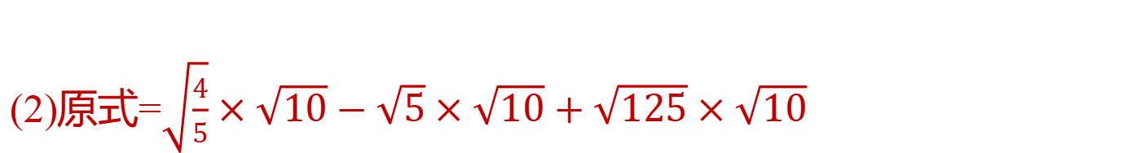
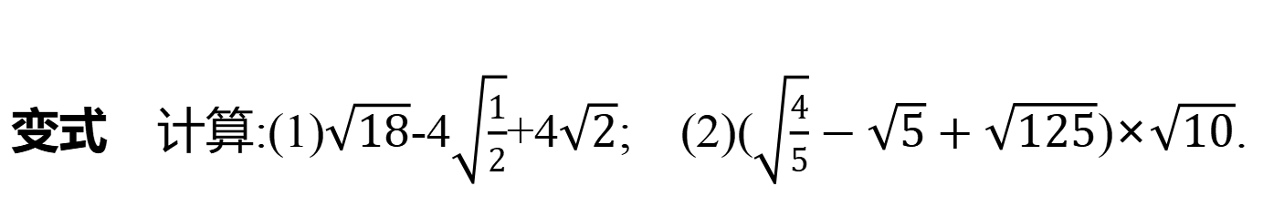
变式 计算:(1)$\sqrt{18}$-4$\sqrt{\frac{1}{2}}$+4$\sqrt{2}$; (2)($\sqrt{\frac{4}{5}}−\sqrt{5}+\sqrt{125}$)×$\sqrt{10}$.
  解:(1)原式=3$\sqrt{2}$-2$\sqrt{2}$+4$\sqrt{2}$=5$\sqrt{2}$.
  (2)原式=$\sqrt{\frac{4}{5}}×\sqrt{10}−\sqrt{5}×\sqrt{10}+\sqrt{125}×\sqrt{10}$
  =$\sqrt{4×2}−\sqrt{25×2}$+5$\sqrt{5×10}$
  =2$\sqrt{2}$-5$\sqrt{2}$+25$\sqrt{2}$
  =22$\sqrt{2}$.

Slide 8
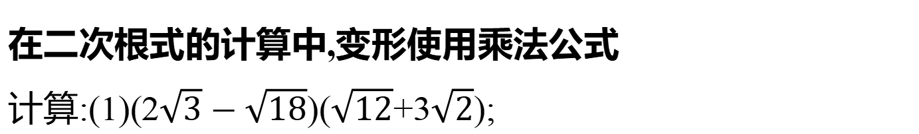
【延伸拓展】
在二次根式的计算中,变形使用乘法公式
计算:(1)(2$\sqrt{3}−\sqrt{18}$)($\sqrt{12}$+3$\sqrt{2}$);
  解:原式=(2$\sqrt{3}$-3$\sqrt{2}$)(2$\sqrt{3}$+3$\sqrt{2}$)=(2$\sqrt{3}$)²-(3$\sqrt{2}$)²=12-18=-6.

Slide 9
(2) ($\sqrt{3}$+3$\sqrt{2}−\sqrt{6}$) ($\sqrt{3}$-3$\sqrt{2}−\sqrt{6}$).
  解: ($\sqrt{3}$+3$\sqrt{2}−\sqrt{6}$)($\sqrt{3}$-3$\sqrt{2}−\sqrt{6}$)
  =[($\sqrt{3}−\sqrt{6}$)+(3$\sqrt{2}$)][($\sqrt{3}−\sqrt{6}$)-3$\sqrt{2}$]
  =($\sqrt{3}−\sqrt{6}$)²-(3$\sqrt{2}$)²
  =3-6$\sqrt{2}$+6-18
  =-9-6$\sqrt{2}$.

Slide 10
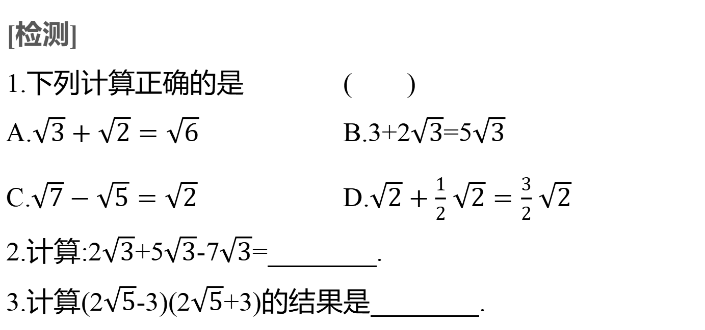
[检测]
1.下列计算正确的是 ( )
A.$\sqrt{3}+\sqrt{2}=\sqrt{6}$ B.3+2$\sqrt{3}$=5$\sqrt{3}$
C.$\sqrt{7}−\sqrt{5}=\sqrt{2}$ D.$\sqrt{2}+\frac{1}{2}$ $\sqrt{2}=\frac{3}{2}$ $\sqrt{2}$
2.计算:2$\sqrt{3}$+5$\sqrt{3}$-7$\sqrt{3}$= .
3.计算(2$\sqrt{5}$-3)(2$\sqrt{5}$+3)的结果是 .
D
0
11

Slide 11
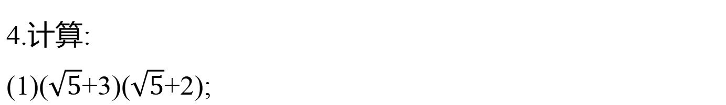
4.计算:
(1)($\sqrt{5}$+3)($\sqrt{5}$+2);
(2)(5-$\sqrt{3}$)²;
(3)(3$\sqrt{2}$-2$\sqrt{3}$)(3$\sqrt{2}$+2$\sqrt{3}$);
  解:(1)($\sqrt{5}$+3)($\sqrt{5}$+2)=5+2$\sqrt{5}$+3$\sqrt{5}$+6=11+5$\sqrt{5}$.
  (2)(5-$\sqrt{3}$)²=25-10$\sqrt{3}$+3=28-10$\sqrt{3}$.
  (3)(3$\sqrt{2}$-2$\sqrt{3}$)(3$\sqrt{2}$+2$\sqrt{3}$)=(3$\sqrt{2}$)²-(2$\sqrt{3}$)²=18-12=6.

